Slide 1

Distributed Computing at Google
Author: Murray Stokely <mstokely@google.com>
Presenter: Pim van Pelt <pim@google.com>
Notes:
Today we’ll talk about some of the less user-visible technologies and challenges we face at Google, which are those involved in developing and operating our computing platform.

Slide 2
Guidelines for this talk.
I am not presenting my own personal work. I did not invent the Google infrastructure components I will describe.
Requests for clarification or quick questions welcomed throughout, please save longer questions until the end.
I won’t tell you how many machines Google currently uses, how many queries we answer and how many megabits we generate.
Notes:
Key point in the slide: we have a somewhat unique computing infrastructure, and there are lots of research-grade technical problems and some of our brightest people working on them.

Slide 3
Google Technology Layers
Services and Applications
Web search
GMail
Ads system
Google Maps
Distributed systems
infrastructure
Computing platform
Cheap PC Hardware
Linux
Physical networking
Notes:
This is here just to position the audience and help them understand what the talk is about. Try not to spend much time in this at all.

Slide 4
Google’s Explosive Computational Requirements
Every Google service sees continuing growth in computational needs
  More queries
    More users, happier users
  More data
    Bigger web, mailbox, blog, etc.
  Better results
    Find the right information, and find it faster
more
data
more
queries
better
results
Notes:
Motivational slide which sets up the next one. Key point to make is that we are in a very compute intensive business, and our differentiation comes in part from our ability to throw more computing resources (CPUs, storage, etc) into problems than our competitors.

Slide 5
A Simple Challenge For Our Compute Infrastructure
Create the world’s largest computing infrastructure.
Make it easier for developers to write parallel code than not to.
Need to drive efficiency of the computing infrastructure to unprecedented levels.
Notes:
Emphasizing further that efficiency is key, since much of the talk will refer back to this point.

Slide 6
The Building Blocks of google.com
Distributed storage: GFS, BigTable.
The workqueue.
Parallel computation: MapReduce, Sawzall.
Distributed lockserver: chubby.

Slide 7
GFS: The Google File System
Reliable distributed storage system for petabyte scale filesystems.
Data kept in 64-megabyte “chunks” stored on disks spread across thousands of machines
Each chunk replicated, usually 3 times, on different machines so that GFS can recover seamlessly from disk or machine failure.
A GFS cluster consists of a single master, multiple chunkservers, and is accessed by multiple clients.

Slide 8
GFS: The Google File System
GFS Master
Misc. servers
Replicas
Masters
Client
GFS Master
Client
Client
C₀
C₁
C₁
C₀
C₅
Chunkserver 1
Chunkserver 2
…
Chunkserver N
C₅
C₂
C₅
C₃
C₂
Master manages metadata
Data transfers happen directly between clients/chunkservers
Files broken into chunks (typically 64 MB)‏
Chunks triplicated across three machines for safety
See SOSP’03 paper at http://labs.google.com/papers/gfs.html
Notes:
Let’s discuss how we scale our search.
The most important point is that the index is read-only, so we do not have to handle concurrent updates, which make distributed databases so difficult.
We crawl the web periodically and we generate the index. Then we push read-only copies of the index to our data centers.

Slide 9
BigTable
A distributed storage system for managing structured data that is designed to scale to a very large size: petabytes of data across thousands of commodity servers.
Built on top of GFS.
Used by more than 60 Google products and projects including Google Earth, Google Finance, Orkut, …
Paper by Fay Chang, Jeffrey Dean, Sanjay Ghemawat, et al appeared at OSDI'06.
http://labs.google.com/papers/bigtable.html

Slide 10
BigTable: An Example for crawl data
A web crawling system might use BigTable that stores web pages.
Each row key could represent a specific URL, with columns for the page contents, the language, the references to that page, or other metadata.
The row range for a table is dynamically partitioned between servers.
Rows are clustered together on machines by key, so using URLs as keys would minimize the number of machines where pages from a single domain are stored.
Each cell is timestamped so there could be multiple versions of the same data in the table.

Slide 11
Workqueue: Scheduling many jobs on many machines
A large scale time sharing system built out of an array of computers and their ram, cpus and disks.
Schedules jobs, allocates resources, reports status, and collects the results.
Similar to other distributed systems described in the literature, such as Condor.
The same machines that serve as chunkservers for a GFS cell can also contribute CPU and memory resources to a workqueue because the computational requirements of a GFS storage cell are negligible.
So a machine A may contribute to storage cluster (GFS cell) B and also to compute cluster (workqueue) C -- the compute and storage cells can (and will) overlap.

Slide 12
Workqueue: Scheduling many jobs on many machines
Machine 1
Machine N
Job 0
task
Bigmemory job task
Job 2
task
Bigmemory job task
…
GFS
Chunkserver
Workqueue
slave
GFS
Chunkserver
Workqueue
slave
Workqueue
master
GFS Master

Slide 13
MapReduce
A programming model and an associated implementation for processing and generating large data sets.
A user specified map function processes a key/value pair to generate a set of intermediate key/value pairs.
A user specified reduce function merges all intermediate values associated with the same intermediate key.
Programs written in this functional style are automatically parallelized and executed on a large cluster of commodity machines.

Slide 14
MapReduce: Runtime Environment
The MapReduce runtime environment takes care of:
  Partitioning the input data.
  Scheduling the program’s execution across a set of machines.
  Handling machine failures.
  Managing required inter-machine communication.
Allows programmers without any experience with parallel and distributed systems to easily utilize the resources of a large distributed cluster.
All at the application level built on top of Linux.

Slide 15
MapReduce: Grep for Sysadmins
Suppose we wanted a distributed grep over a large data set.
  cat file | grep “ip address” > matches.txt
Our input is really large, so we’ll need to read it from a distributed file system anyway.
A distributed grep with MapReduce would :
  Split up the file into individual chunks.
  Send each small chunk to a different machine.
  Have each of the machines run the same mapper on their data chunk (grep “ip address” in this case)‏
  Collate the matches from the individual worker machines into an output file (the reducer, in this example the Identity function).
System Optimizations possible:
  Data locality
  Network topology optimizations (rack diversity, etc..)‏

Slide 16
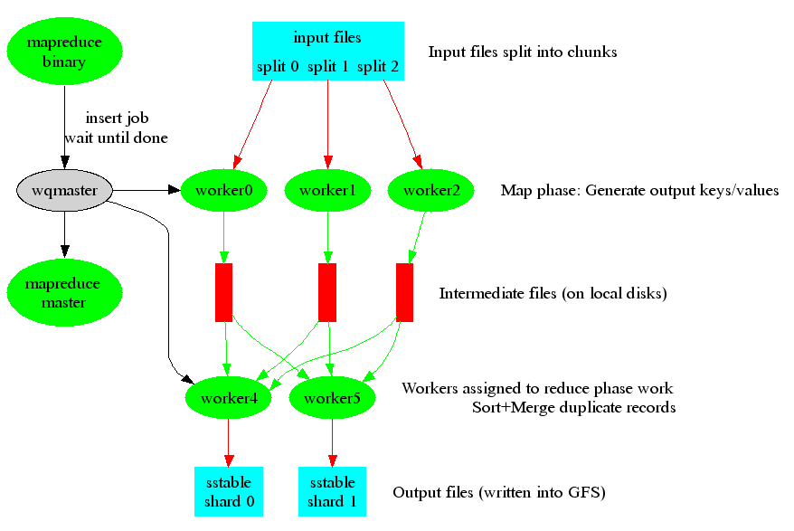
MapReduce: System Structure
See: “MapReduce: Simplified Data Processing on Large Clusters”, OSDI’04
  (http://labs.google.com/papers)‏

Slide 17
MapReduce: An Example
Example: compute the Inverse Document Frequency
for a list of urls, return the number of documents each word occurs in
Input is sequence of key/value pairs
  e.g. “www.swinog.ch/elgoog.html” => “organize world information”
Users write two simple functions:
  Map: takes input k1/v1 and produces set of intermediate k2/v2 pairs
    E.g. map(url, contents) -> “world” => “1"
    -> “information” => “1”
  Reduce: takes intermediate k2/v2, combines to produce output k2/v3
    E.g. reduce(“world” => {“1”,”1”,”1”,”1”}) -> world => “4”
k2/v3 value are emitted to an output file

Slide 18
One step further - Sawzall
An interpreted language built on top of the Map Reduce framework.
Examines one record at a time:
->Write a Map Reduce using 5 lines of code
  Scientific Programming Issue: Volume 13, Number 4, 2005: Interpreting the data: Parallel analysis with Sawzall, Rob Pike, Sean Dorward, Robert Griesemer, Sean Quinlan

Slide 19
Sawzall – An Example
Uses MapReduce
  Do stuff with raw data on many machines (mapper)‏
  Aggregate sorted data (reducer)‏
Collect, collate and format the output
count: table sum of int;
total: table sum of float;
sum_of_squares: table sum of float;
x: float = input;
emit count <- 1;
emit total <- x;
emit sum_of_squares <- x * x;

Slide 20
Chubby – A Distributed lockservice
Exports a filesystem interface, similar to unix
Directory based approach:
  /ls/foo/wombat/pouch
Generic operations: create, read, write, lock
Callbacks on data stored in Chubby:
  File contents changed
  Child node added, removed, changed
  Lock expired, lock competition, ...
  Chubby master failure

Slide 21
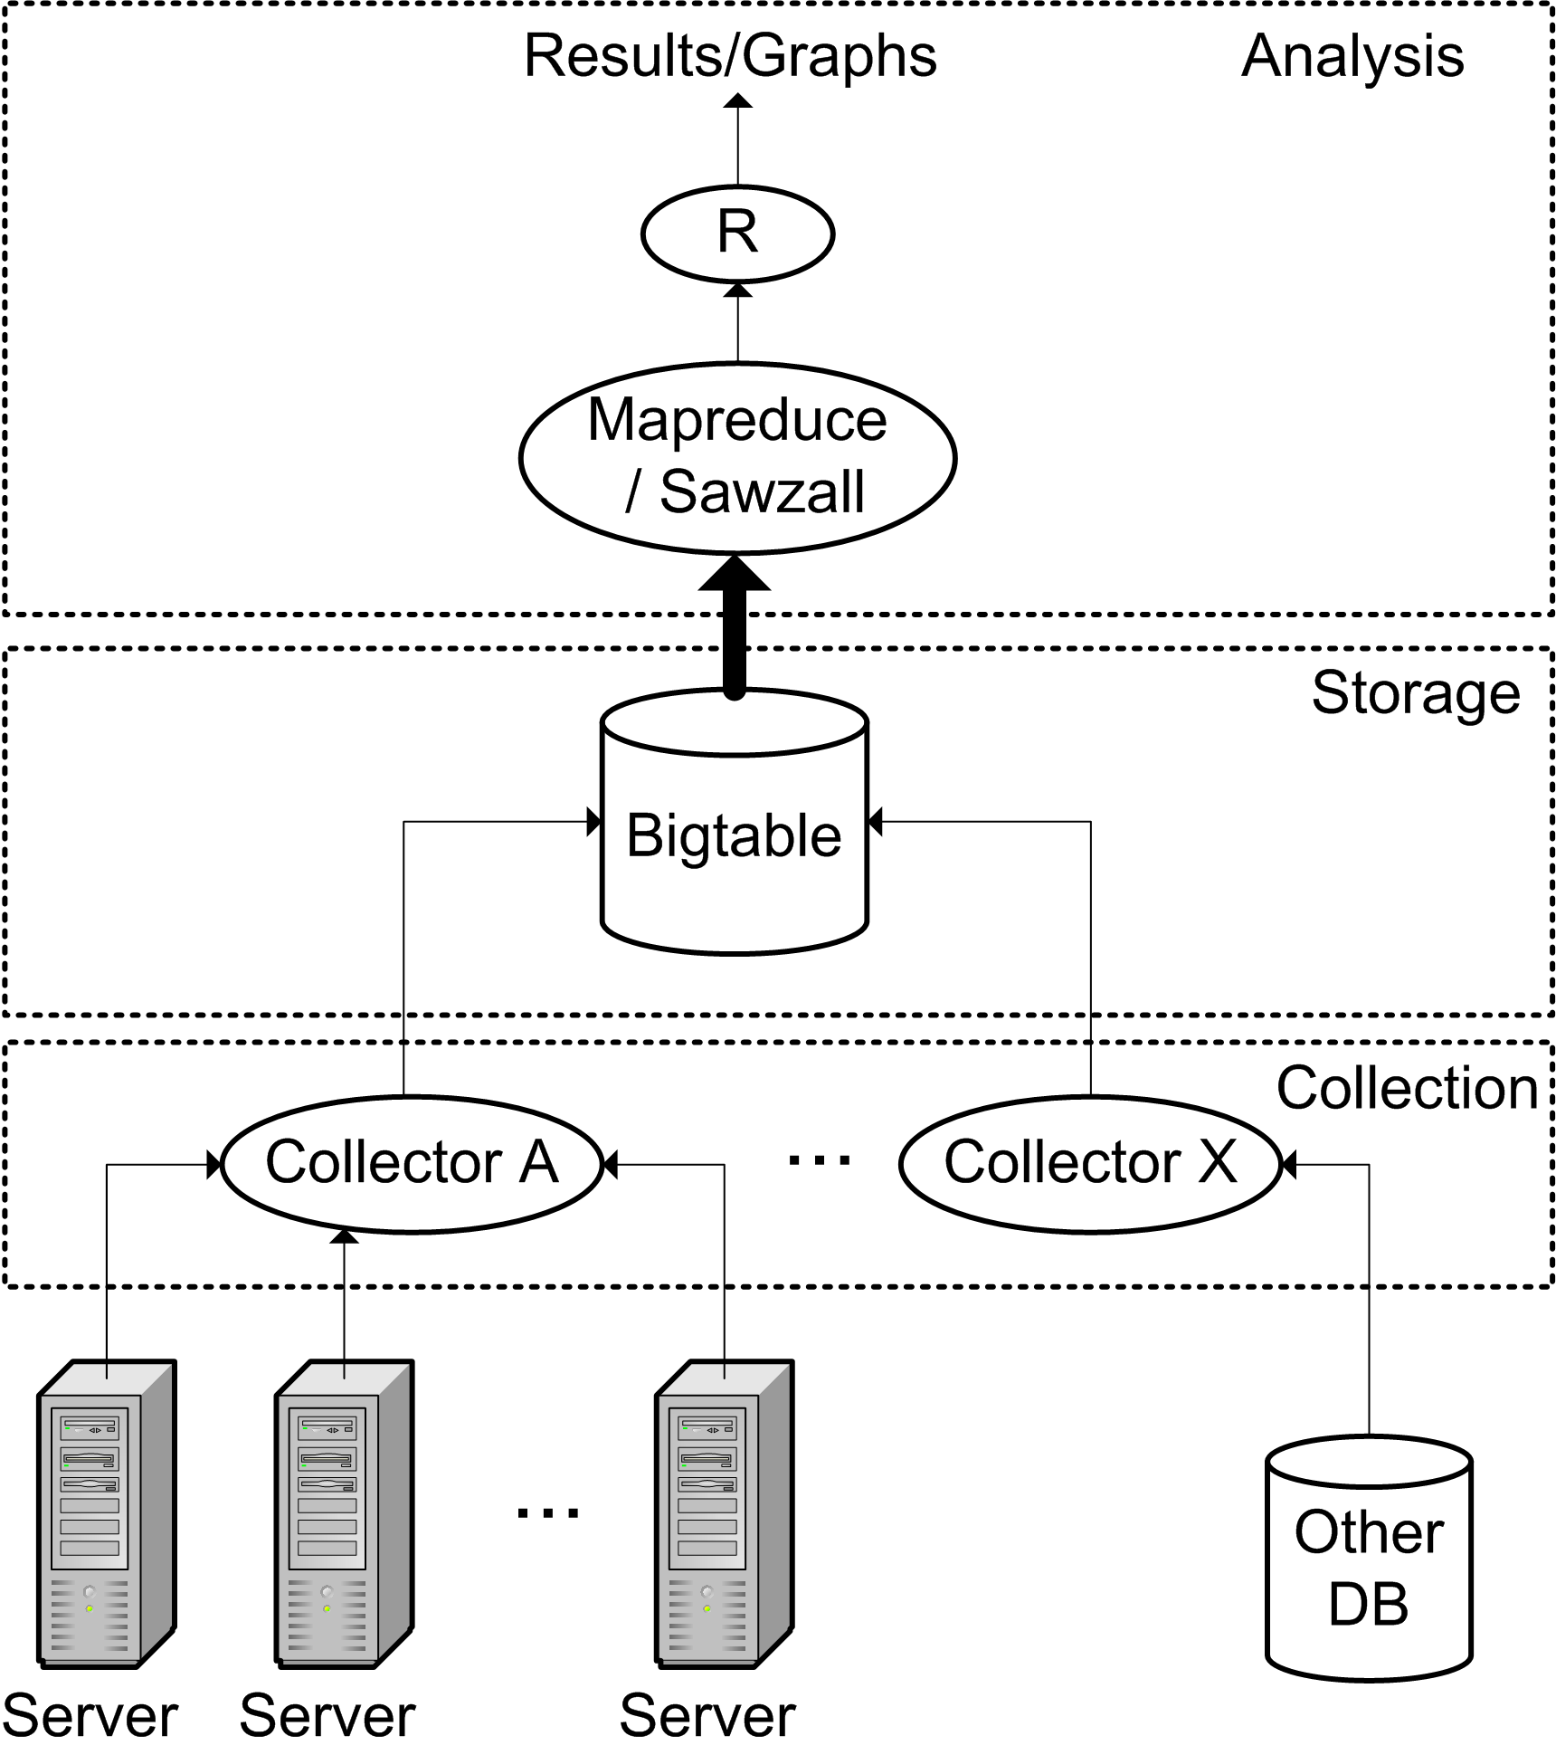
Dogfood: The System Health Infrastructure
Talks to every server frequently
Collects
  Health signals
  Activity information
  Configuration data
Stores time-series data forever
Enable highly parallel analysis of repository data
Notes:
Make sure to mention that a key feature of this system is that it allows massively parallel analysis of all this data. You may also highlight that this is a fairly complex distributed system in its own right (with collection, storage and analysis components).
This is lifted from the System Health work, by Wolf Weber, Xiaobo Fan, Don Yang, Greg Slaughter, Eduardo Pinheiro and others.

Slide 22
Many Thanks!
Murray Stokely
Jeff Dean
Sanjay Ghemawat
Rob Pike
Tom Limoncelli
Shun-Tak Leung
Howard Gobioff
Luiz Barroso

